Slide 1

Database Management System
By:
Chesta 20EE30010

Slide 2

“You can have data without information, but you cannot have information without data.”
– Daniel Keys Moran, an American computer
programmer and science fiction writer.
This Photo by Unknown author is licensed under CC BY.

Slide 3
WHAT IS DATABASE ?
Database is a collection of inter-related data which helps in efficient retrieval, insertion and deletion of data from database and organizes the data in the form of tables, views, schemas, reports etc.
For Example, university database organizes the data about students, faculty, and admin staff etc. which helps in efficient retrieval, insertion and deletion of data from it.
The software which is used to manage database is called Database Management System (DBMS). For Example, MySQL, Oracle etc. are popular commercial DBMS used in different applications.

Slide 4


If you burned all of the data created in just one day onto DVDs, you could stack them on top of each other and reach and return the moon – twice.
This Photo by Unknown author is licensed under CC BY-SA.

Slide 5
ADVANTAGES OF DBMS OVER FILE SYSTEM
Easy access to data, easy recovery and flexible
No redundant data: Redundancy removed by data normalization. No data duplication saves storage and improves access time.
Data Consistency and Integrity
Privacy: Limited access means privacy of data.
Data Security: Each user has a different set of access thus data is secured from the issues such as identity theft, data leaks and misuse of data.

Slide 6
SQL | No SQL
RELATIONAL DATABASE MANAGEMENT SYSTEM (RDBMS) | Non-relational or distributed database system.
These databases have fixed or static or predefined schema | They have dynamic schema
These databases are not suited for hierarchical data storage. | These databases are best suited for hierarchical data storage.
These databases are best suited for complex queries | These databases are not so good for complex queries
Vertically Scalable | Horizontally scalable
Follows ACID property | Follows CAP(consistency, availability, partition tolerance)

Slide 7

KEYS IN DATABASES

Slide 8
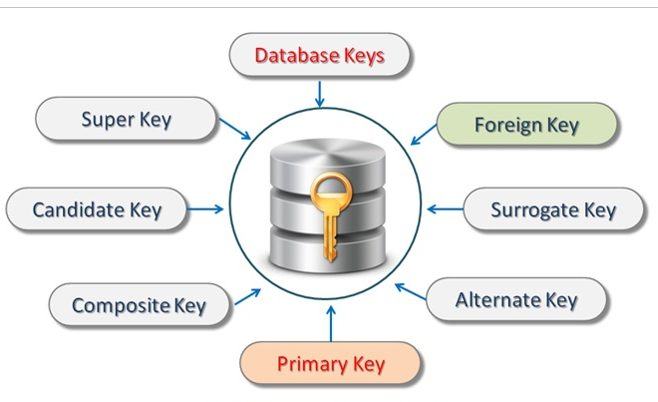
A key in DBMS is an attribute or a set of attributes that help to uniquely identify a tuple (or row) in a relation (or table). Keys are also used to establish relationships between the different tables and columns of a relational database. Individual values in a key are called key values.

Slide 9
TYPES OF KEYS IN DATABASES

Slide 10

Primary Key
It is a column or group of columns in a table that uniquely identify every row in that table.
Candidate key
Super key
It is a group of single or multiple keys which identifies rows in a table.
It is a set of attributes that uniquely identify tuples in a table. Candidate Key is a super key with no repeated attributes.
Alternate Key -
It is a column or group of columns in a table that uniquely identify every row in that table.
Foreign key
It is a column that creates a relationship between two tables. The purpose of Foreign keys is to maintain data integrity and allow navigation between two different instances of an entity.
This Photo by Unknown author is licensed under CC BY-NC-ND.

Slide 11
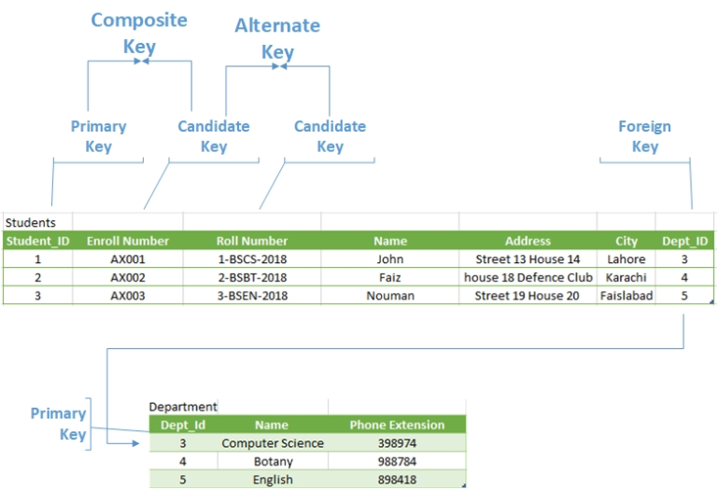

Slide 12

INTRODUCTION TO ER MODEL

Slide 13
ER Model is used to model the logical view of the system from data perspective which consists of these components:
Entity: An Entity may be an object with a physical existence – a particular person, car, house, or employee – or it may be an object with a conceptual existence – a company, a job, or a university course.
Entity Type: An Entity is an object of Entity Type
Entity Set : Set of all entities is called as entity set. e.g.; E1 is an entity having Entity Type Student and set of all students is called Entity Set.

Slide 14
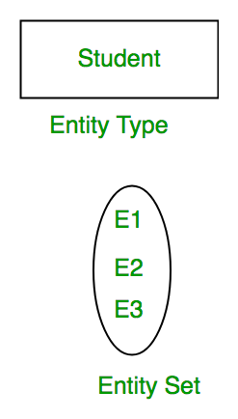
Entity Type in ER diagram

Slide 15
RELATIONSHIP TYPES

Slide 16
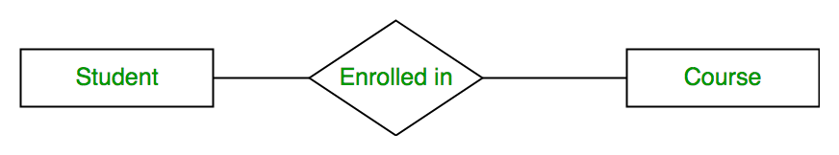
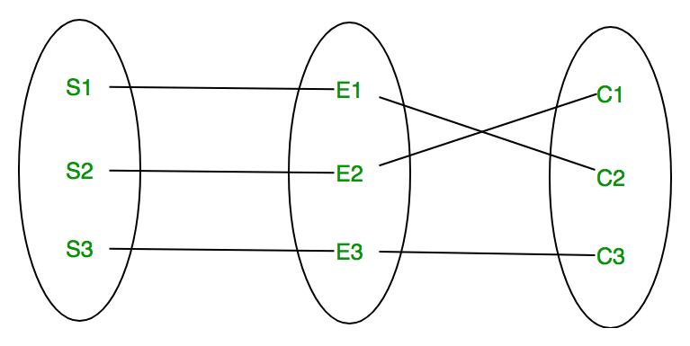
A relationship type represents the association between entity types. For example, ‘Enrolled in’ is a relationship type that exists between entity type Student and Course. In ER diagram, relationship type is represented by a diamond and connecting the entities with lines.
A set of relationships of same type is known as relationship set. The following relationship set depicts S1 is enrolled in C2, S2 is enrolled in C1 and S3 is enrolled in C3.

Slide 17
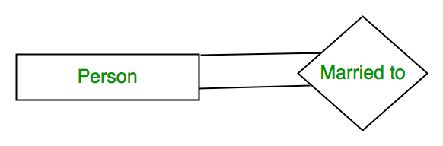
Degree of a relationship set: The number of different entity sets participating in a relationship set
Unary Relationship
When there is only ONE entity set participating in a relation, the relationship is called as unary relationship. For example, one person is married to only one person.
When there are TWO entities set participating in a relation, the relationship is called as binary relationship. For example, Student is enrolled in Course.
Binary Relationship
N-ary Relationship
When there are n entities set participating in a relation, the relationship is called as N-ary relationship.

Slide 18
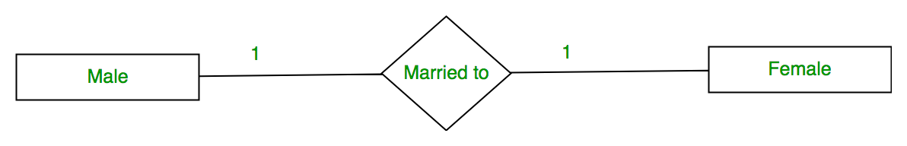
Cardinality: The number of times an entity of an entity set
participates in a relationship set.​ ​ Different types of Cardinality are:
One to one
When each entity in each entity set can take part only once in the relationship, the cardinality is one to one.
Let us assume that a male can marry to one female and a female can marry to one male. So the relationship will be one to one.

Slide 19
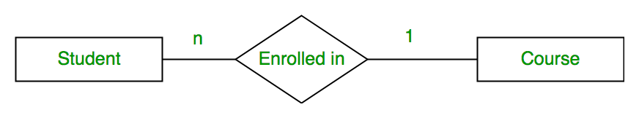
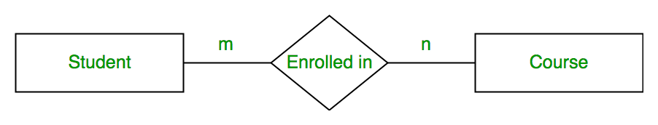
Many to one
When entities in one entity set can take part only once in the relationship set and entities in other entity set can take part more than once in the relationship set, cardinality is many to one.
Let us assume that a student can take only one course but one course can be taken by many students. So the cardinality will be n to 1. It means that for one course there can be n students but for one student, there will be only one course.
Many to many
When entities in all entity sets can take part more than once in the relationship cardinality is many to many.
Let us assume that a student can take more than one course and one course can be taken by many students. So the relationship will be many to many.

Slide 20

If you were collecting and storing information about your music collection, an album would be considered as:
a) Relation b) Entity c) Instance d) Attribute
Sol: b

Slide 21
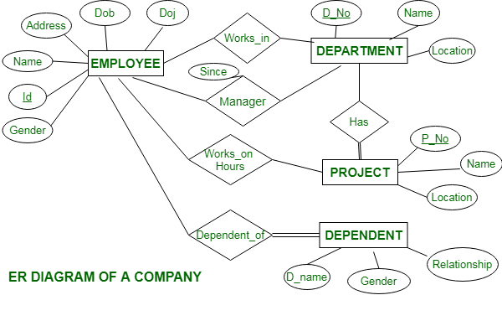
This Company ER diagram illustrates key information about Company, including entities such as employee, department, project and dependent. It allows to understand the relationships between entities.

Slide 22

EXAMPLE OF
ER DIAGRAM
This Photo by Unknown author is licensed under CC BY.

Slide 23
Entities and their Attributes are:
Employee Entity :
Attributes of Employee Entity are Name, Id, Address, Gender, Dob and Doj.
Department Entity :
Attributes of Department Entity are D_no, Name and Location.
D_no is Primary Key for Department Entity.
Project Entity :
Attributes of Project Entity are P_No, Name and Location.
P_No is Primary Key for Project Entity.
Id is Primary Key for Employee Entity.
Dependent Entity :
Attributes of Dependent Entity are D_no, Gender and relationship.

Slide 24

Relationships
Employees works in Departments –
Many employee works in one Department but one employee can not work in many departments.
Manager controls a Department –
Employee works under the manager of the Department and the manager records the date of joining of employee in the department.
Department has many Projects –
One department has many projects but one project can not come under many departments.
One employee works on several projects and the number of hours worked by the employee on a single project is recorded.
Employee works on project –
Employee has dependents –
Each Employee has dependents. Each dependent is dependent of only one employee.

Slide 25

Referential Integrity

Slide 26
Referential Integrity Constraints :
The Referential integrity constraints is specified between two relations or tables and used to maintain the consistency among the tuples in two relations.
This constraint is enforced through foreign key, when an attribute in the foreign key of relation R1 have the same domain(s) as the primary key of relation R2, then the foreign key of R1 is said to reference or refer to the primary key of relation R2.
The values of the foreign key in a tuple of relation R1 can either take the values of the primary key for some tuple in relation R2, or can take NULL values, but can’t be empty.

Slide 27
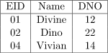
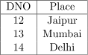
EXAMPLE:
In the above, DNO of the first relation is the foreign key, and DNO in the second relation is the primary key.
DNO = 22 in the foreign key of the first table is not allowed since DNO = 22 is not defined in the primary key of the second relation. Therefore, Referential integrity constraints is violated here

Slide 28

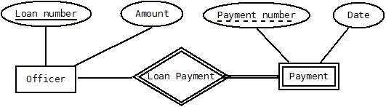
WEAK ENTITY SET
The entity sets which do not have sufficient attributes to form a primary key are known as weak entity sets and the entity sets which have a primary key are known as strong entity sets.
Example:
In the below ER Diagram, ‘Payment’ is the weak entity. ‘Loan Payment’ is the identifying relationship and ‘Payment Number’ is the partial key. Primary Key of the Loan along with the partial key would be used to identify the records.

Slide 29

Normal Forms in DBMS

Slide 30
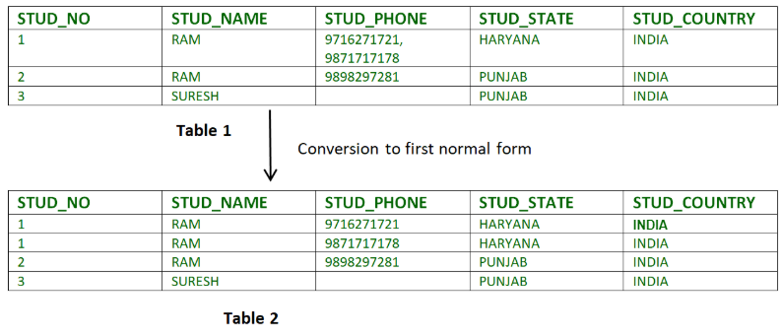
Normalization is the process of minimizing redundancy from a relation or set of relations. Redundancy in relation may cause insertion, deletion and updating anomalies. So, it helps to minimize the redundancy in relations. Normal forms are used to eliminate or reduce redundancy in database tables
First Normal Form : If a relation contain composite or multi-valued attribute, it violates first normal form or a relation is in first normal form if it does not contain any composite or multi-valued attribute. A relation is in first normal form if every attribute in that relation is singled valued attribute.
Example 1 – Relation STUDENT in table 1 is not in 1NF because of multi-valued attribute STUD_PHONE. Its decomposition into 1NF has been shown in table 2.

Slide 31
Second Normal Form – To be in second normal form, a relation must be in first normal form and relation must not contain any partial dependency. A relation is in 2NF if it has No Partial Dependency, i.e., no non-prime attribute (attributes which are not part of any candidate key) is dependent on any proper subset of any candidate key of the table.
Example – Consider following functional dependencies in relation R (A, B , C, D )​
​
AB -> C [A and B together determine C]​ BC -> D [B and C together determine D]​
​
In the above relation, AB is the only candidate key and there is no partial dependency, i.e., any proper subset of AB doesn’t determine any non-prime attribute.​

Slide 32
Third Normal Form – A relation is in third normal form, if there is no transitive dependency for non-prime attributes as well as it is in second normal form. A relation is in 3NF if at least one of the following condition holds in every non-trivial function dependency X –> Y
X is a super key.
Y is a prime attribute (each element of Y is part of some candidate key).
Example: Consider relation R(A, B, C, D, E) A -> BC, CD -> E, B -> D, E -> A All possible candidate keys in above relation are {A, E, CD, BC} All attribute are on right sides of all functional dependencies are prime.

Slide 33
Boyce-Codd Normal Form (BCNF) – A relation R is in BCNF if R is in Third Normal Form and for every FD, LHS is super key. A relation is in BCNF if in every non-trivial functional dependency X –> Y, X is a super key.
Example 2 –For example consider relation R(A, B, C)​ A -> BC,​ B ->​ A and B both are super keys so above relation is in BCNF.​

Slide 34
STRUCTURED QUERY LANGUAGE

Slide 35


SQL, Lisp, and Haskell are the only programming languages that I’ve seen where one spends more time thinking than typing.
— Philip Greenspun

Slide 36

SQL :
SQL stands for Structured Query Language which is basically a language used by databases. This language allows to handle the information using tables and shows a language to query these tables and other objects related (views, functions, procedures, etc.). Most of the databases like SQL Server, Oracle, PostgreSQL, MySQL, MariaDB handle this language (with some extensions and variations) to handle the data.

Slide 37

When was the current version of Microsoft SQL Server launched?
Sol: 2019

Slide 38

SELECT
Extracts data from a database
UPDATE
Updates data in a database
DELETE
deletes data from a database
INSERT INTO
Inserts new data into a database
CREATE DATABASE
Creates a new database
ALTER DATABASE
Modifies a database
CREATE TABLE
Creates a new table
ALTER TABLE
Modifies a table
DROP TABLE
Deletes a table
CREATE INDEX
Creates an index (search key)
Deletes an index
DROP INDEX
Some important
SQL commands

Slide 39
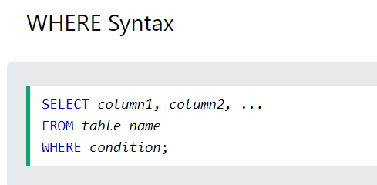
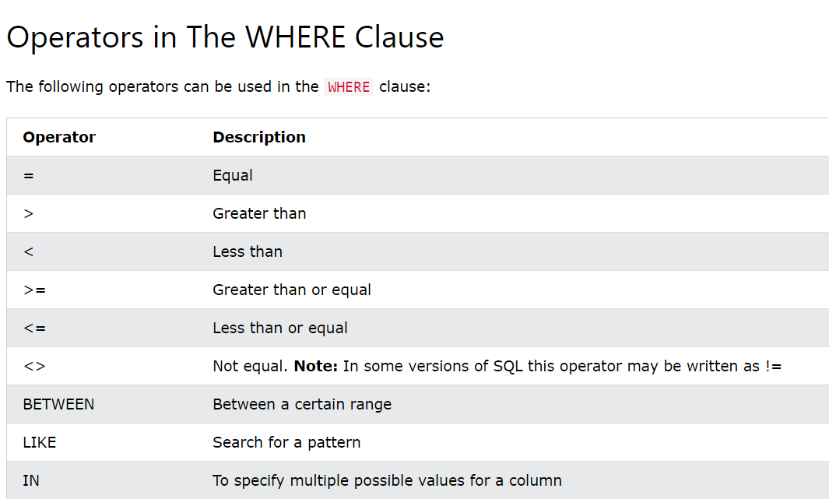
The SQL WHERE Clause
The WHERE clause is used to filter records.
It is used to extract only those records that fulfill a specified condition.

Slide 40
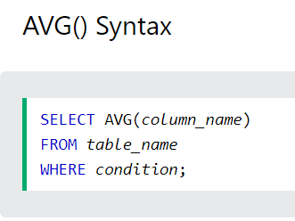
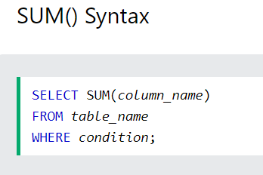
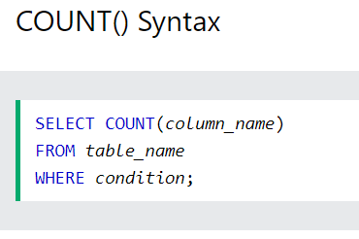
The SQL COUNT(), AVG() and SUM() Functions
The COUNT() function returns the number of rows that matches a specified criterion.
The AVG() function returns the average value of a numeric column.
The SUM() function returns the total sum of a numeric column.

Slide 41
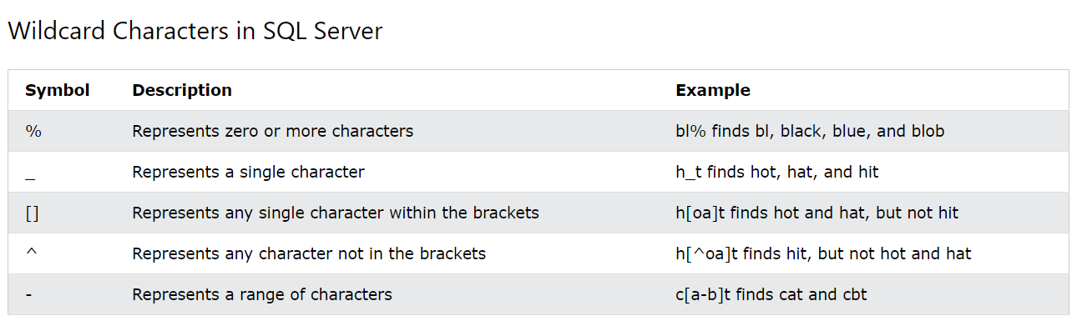
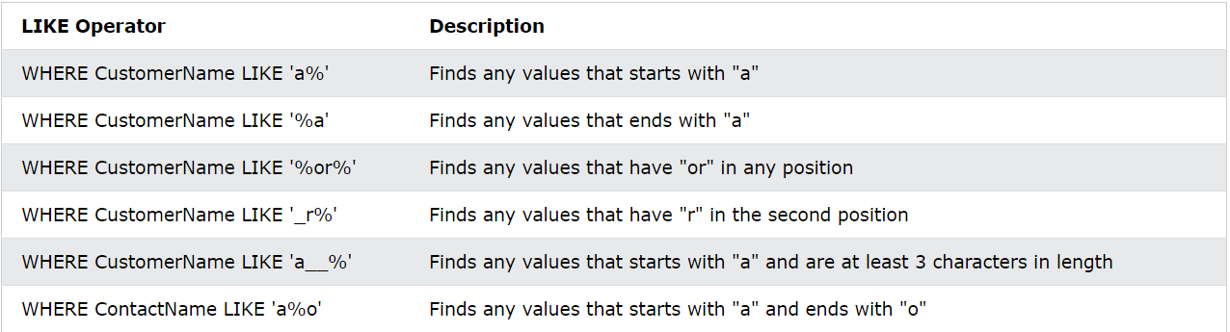
SQL Wildcard Characters:
A wildcard character is used to substitute one or more characters in a string.
Wildcard characters are used with the LIKE operator. The LIKE operator is used in a WHERE clause to search for a specified pattern in a column.

Slide 42
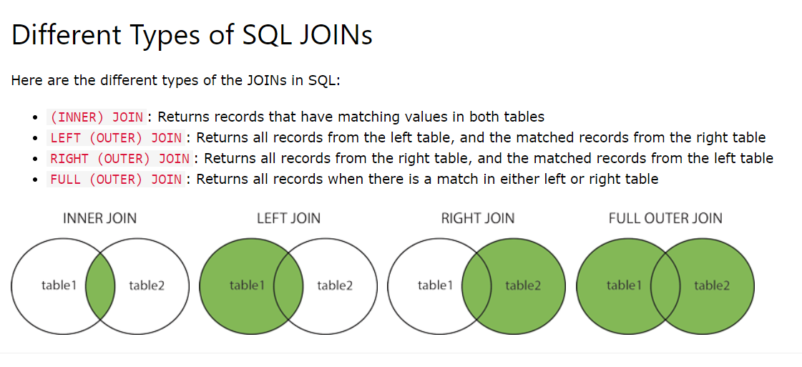
SQL JOIN
A JOIN clause is used to combine rows from two or more tables, based on a related column between them.

Slide 43
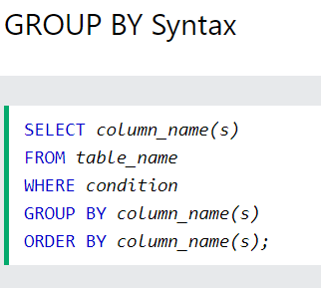
The SQL GROUP BY Statement
The GROUP BY statement groups rows that have the same values into summary rows, like "find the number of customers in each country".
The GROUP BY statement is often used with aggregate functions (COUNT(), MAX(), MIN(), SUM(), AVG()) to group the result-set by one or more columns.

Slide 44



“Technology like art is a soaring exercise of the human imagination.”
– Daniel Bell

Slide 45
THANK YOU

